Slide 1
Digital Signal Processing
Dr. Ahmad Salman
SEECS
Content and Figures are from Discrete-Time Signal Processing, 2e by Oppenheim, Shafer, and Buck, ©1999-2000 Prentice Hall Inc.

Slide 2
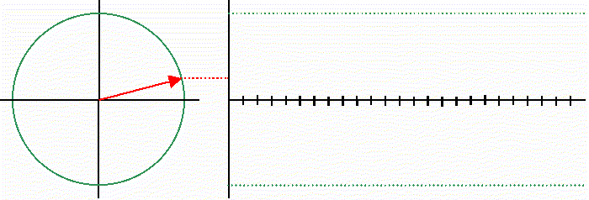
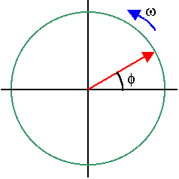
Demo
https://youtu.be/LznjC4Lo7lE

Slide 3


Discrete-Time Systems
Discrete-Time Sequence is a mathematical operation that maps a given input sequence x[n] into an output sequence y[n]
Example Discrete-Time Systems
  Moving (Running) Average
  Maximum
  Ideal Delay System
x[n]
T{.}
y[n]

Slide 4


Memoryless System
Memoryless System
  A system is memoryless if the output y[n] at every value of n depends only on the input x[n] at the same value of n
Example Memoryless Systems
  Square
  Sign
Counter Example
  Ideal Delay System

Slide 5
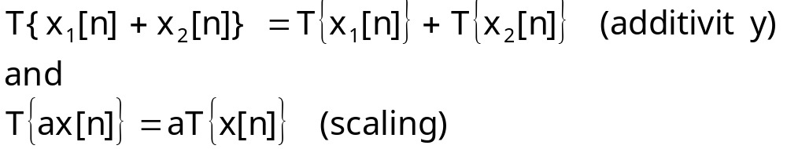

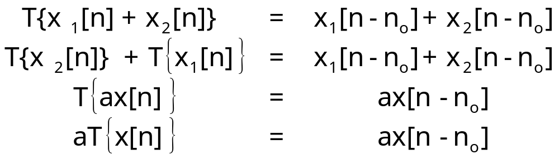
Linear Systems
Linear System: A system is linear if and only if
Examples
  Ideal Delay System

Slide 6
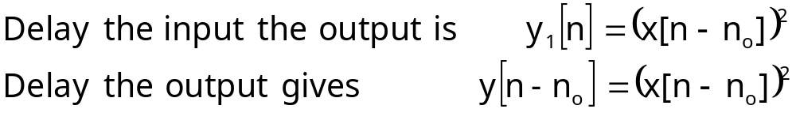
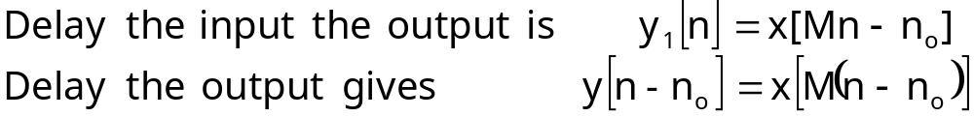

Time-Invariant Systems
Time-Invariant (shift-invariant) Systems
  A time shift at the input causes corresponding time-shift at output
Example
  Square
Counter Example
  Compressor System
Any practical example?

Slide 7
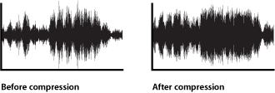
Time-Invariant Systems
Time-Invariant (shift-invariant) Systems
  A time shift at the input causes corresponding time-shift at output
Example
  Square
Counter Example
  Compressor System
Any practical example?

Slide 8


Causal System
Causality
  A system is causal it’s output is a function of only the current and previous samples
Examples
  Backward Difference
Counter Example
  Forward Difference
Any examples?

Slide 9
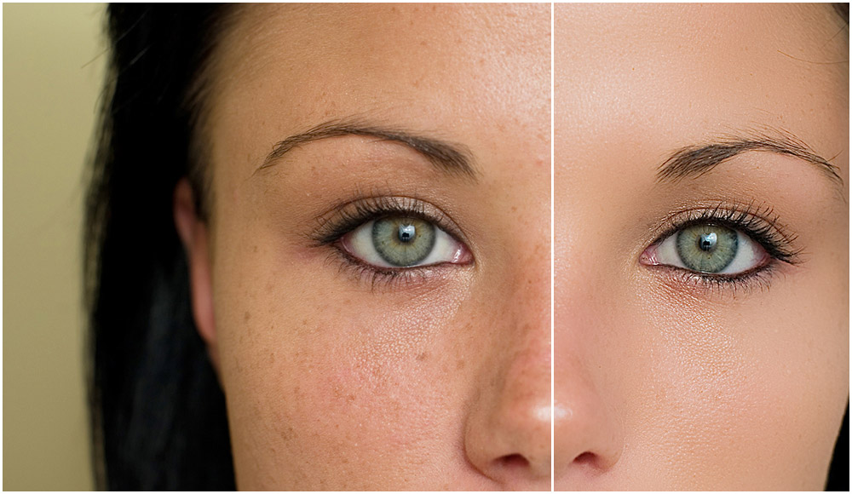
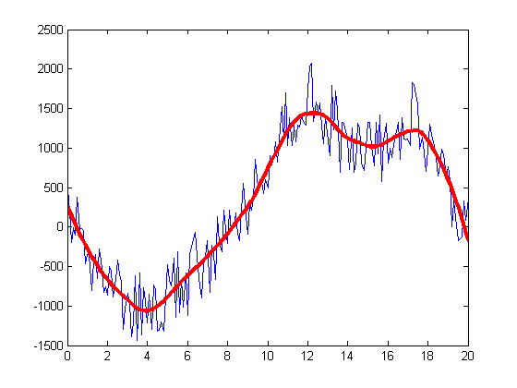
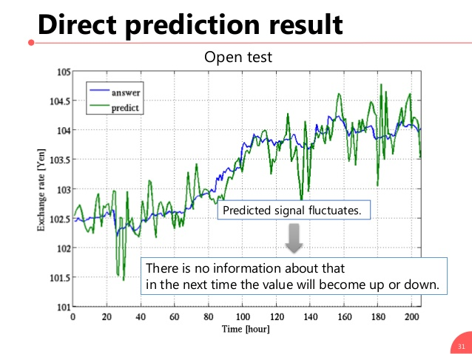
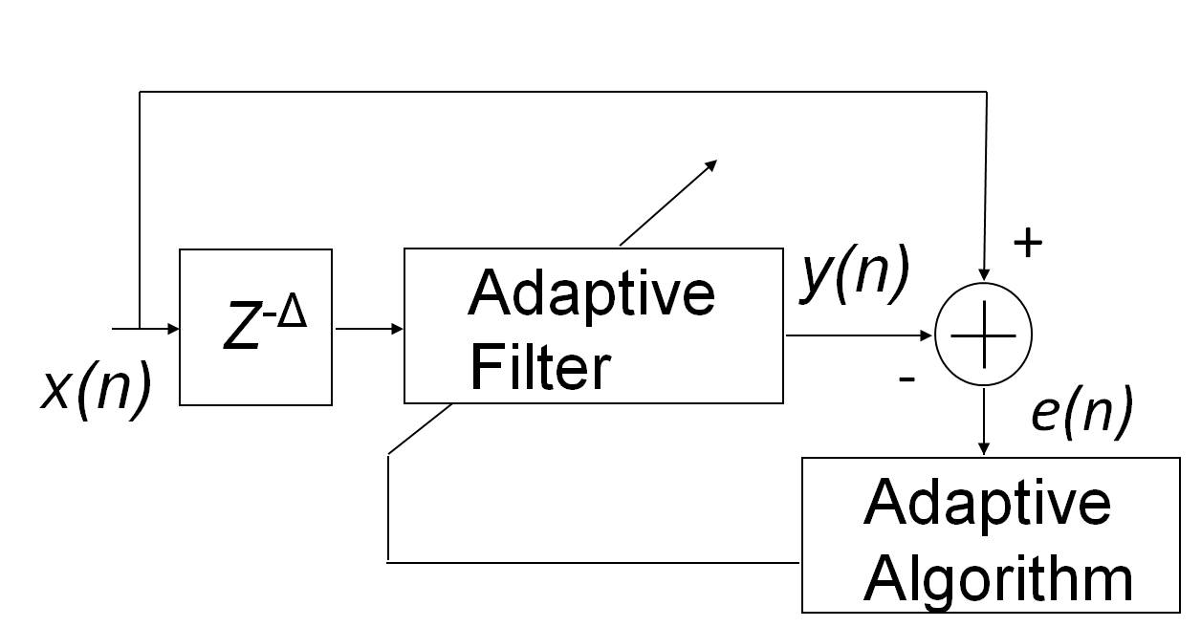
Causal System
Causality
  A system is causal it’s output is a function of only the current and previous samples
Examples
  Backward Difference
Counter Example
  Forward Difference

Slide 10
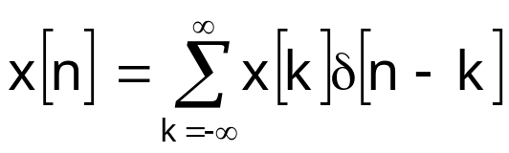
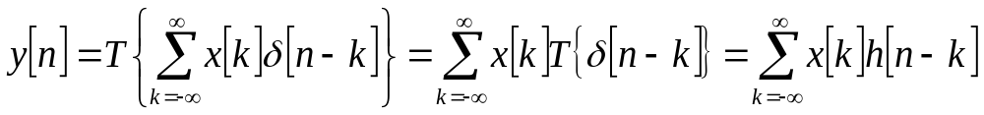
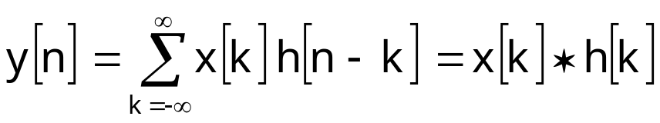
Linear-Time Invariant System
Special importance for their mathematical tractability
Most signal processing applications involve LTI systems
LTI system can be completely characterized by their impulse response
Represent any input
From time invariance we arrive at convolution
x[n]
T{.}
y[n]

Slide 11
Linear-Time Invariant System
Represent any input

Slide 12
Linear-Time Invariant System
Special importance for their mathematical tractability
Most signal processing applications involve LTI systems
LTI system can be completely characterized by their impulse response
Represent any input
From time invariance we arrive at convolution
δ[n-k]
T{.}
h[n-k]
x[n]
T{.}
y[n]

Slide 13
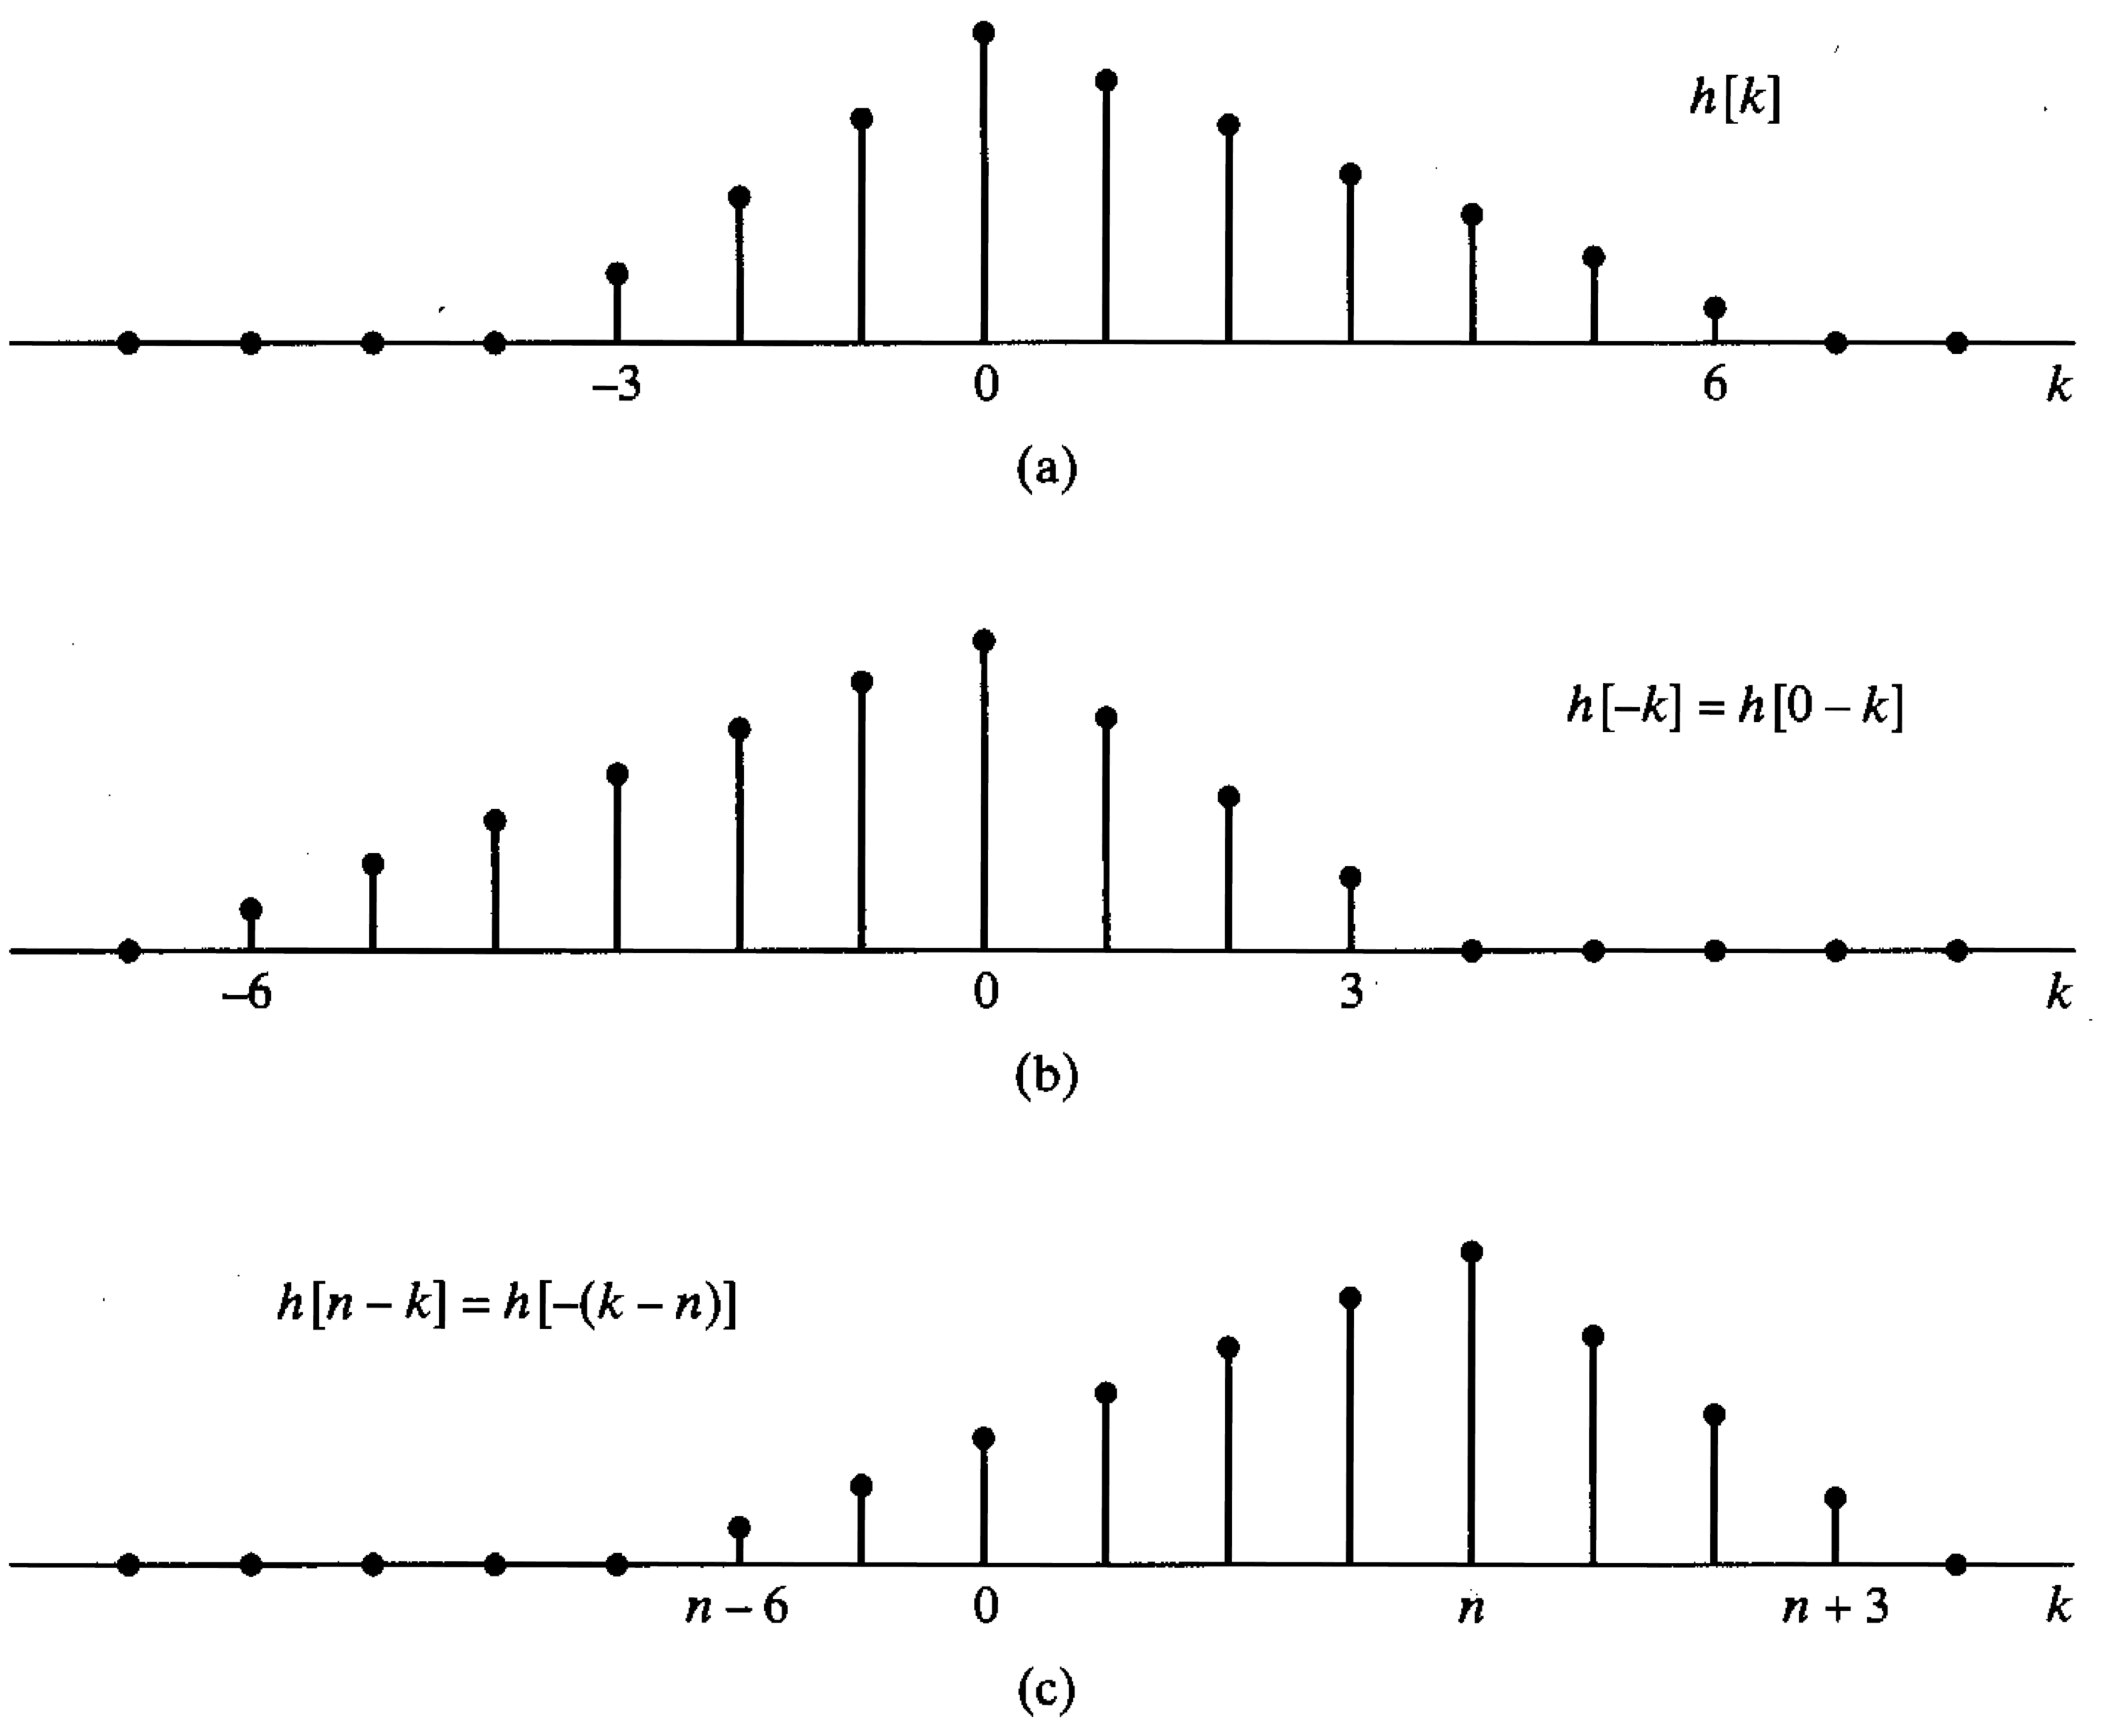
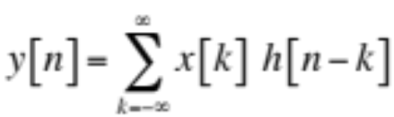
LTI System Example

Slide 14
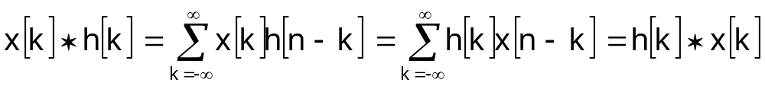
Properties of LTI Systems
Convolution is commutative
Convolution is distributive
x[n]
h[n]
y[n]
h[n]
x[n]
y[n]
h₁[n]
x[n]
y[n]
x[n]
h₁[n]+ h₂[n]
y[n]
+
h₂[n]

Slide 15
Properties of LTI Systems
Cascade connection of LTI systems
x[n]
h₁[n]
h₂[n]
y[n]
x[n]
h₂[n]
h₁[n]
y[n]
x[n]
h₁[n]∗h₂[n]
y[n]

Slide 16
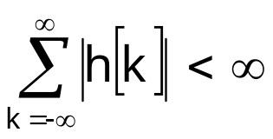
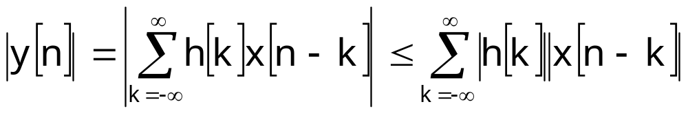

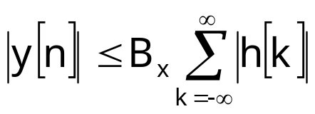

Stable and Causal LTI Systems
An LTI system is (BIBO) stable if and only if
  Impulse response is absolute summable
  Let’s write the output of the system as
  If the input is bounded
  Then the output is bounded by
  The output is bounded if the absolute sum is finite
An LTI system is causal if and only if

Slide 17
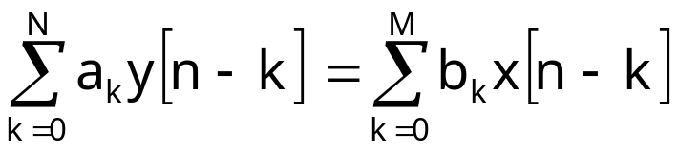
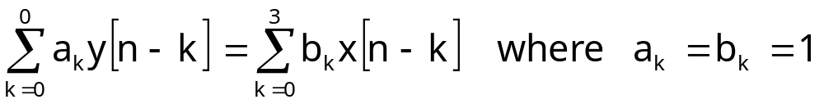
Linear Constant-Coefficient Difference Equations
An important class of LTI systems of the form
The output is not uniquely specified for a given input
  The initial conditions are required
  Linearity, time invariance, and causality depend on the initial conditions
  If initial conditions are assumed to be zero system is linear, time invariant, and causal
Example
  Moving Average
  Difference Equation Representation

Slide 18
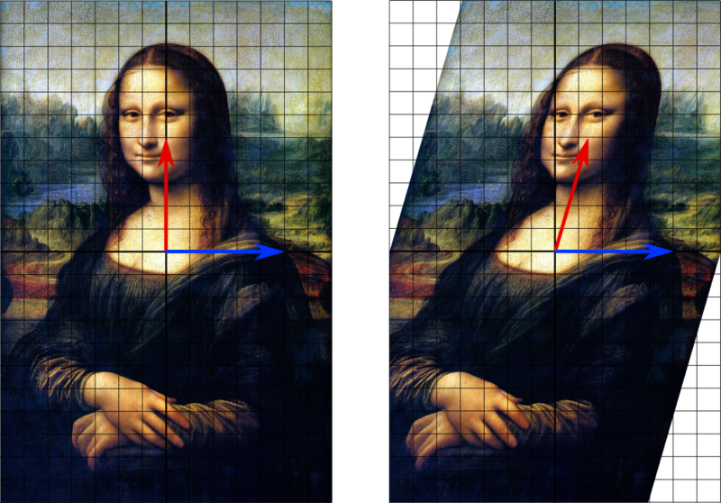
Eigenvalues-Eigenvectors
Blue Arrow = Eigenvector
Eigenvalue = Vector’s length

Slide 19
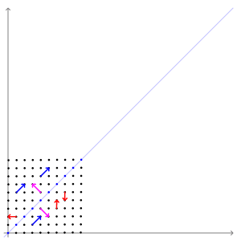
Eigenvalues-Eigenvectors

Slide 20
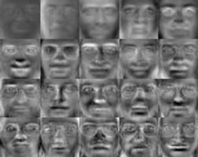
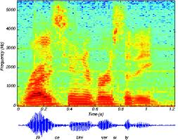
Eigenvalues-Eigenvectors
Applications: Speech/Image/Video processing, Biometrics etc
Eigen Faces
Speech Spectrogram

Slide 21

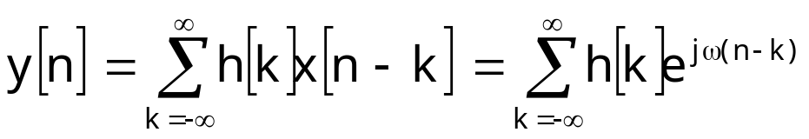
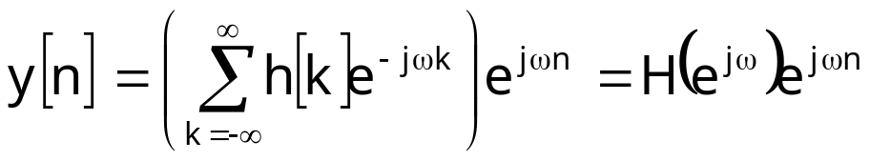
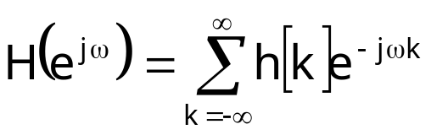
Eigenfunctions of LTI Systems
Complex exponentials are eigenfunctions of LTI systems:
Let’s see what happens if we feed x[n] into an LTI system:
The eigenvalue is called the frequency response of the system
H(e^{jω}) is a complex function of frequency
  Specifies amplitude and phase change of the input
eigenfunction
eigenvalue

Slide 22
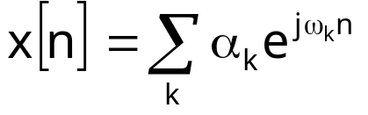
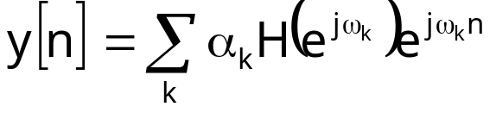
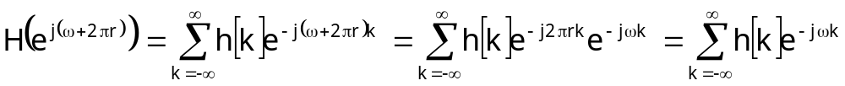

Frequency Response
The frequency response defines a systems output
  for complex exponential at all frequencies
If input signals can be represented as a sum of complex exponentials
  we can determine the output of the system
Different from continuous-time frequency response
  Discrete-time frequency response is periodic with 2π

Slide 23
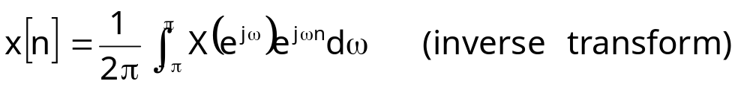
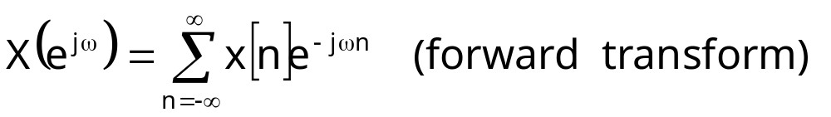
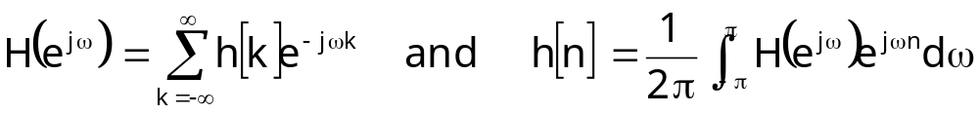
Discrete-Time Fourier Transform
Many sequences can be expressed as a weighted sum of complex exponentials as (another picture)
Where the weighting is determined as
X(e^{jω}) is the Fourier spectrum of the sequence x[n]
  It specifies the magnitude and phase of the sequence
The frequency response of a LTI system is the DTFT of the impulse response

Slide 24
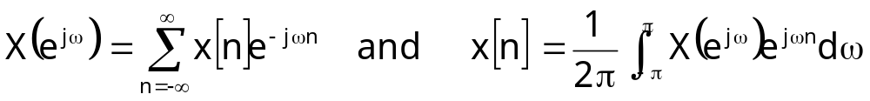
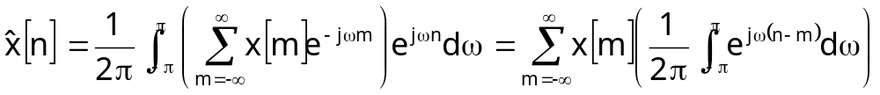
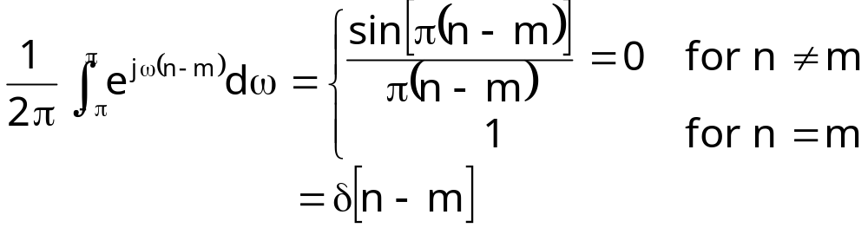
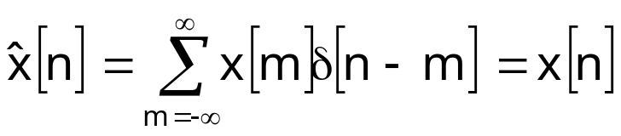
Discrete-Time Fourier Transform Pair
Let’s show that they constitute a transform pair
  Substitute first equation into second to get
  Evaluate the integral
  Substitute the integral with this result to get

Slide 25
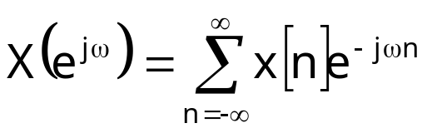
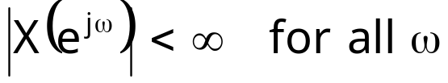
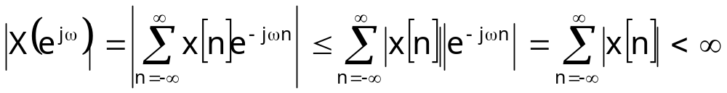
Existence of DTFT
For a given sequence the DTFT exist if the infinite sum convergence
Or
So the DTFT exists if a given sequence is absolute summable
All stable systems are absolute summable and have DTFTs

Slide 26
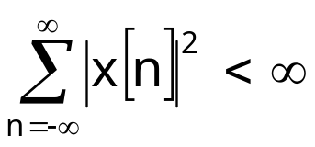
Absolute and Square Summability
Absolute summability is sufficient condition for DTFT
Some sequences may not be absolute summable but only square summable

Slide 27
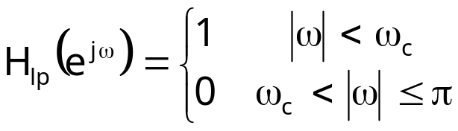
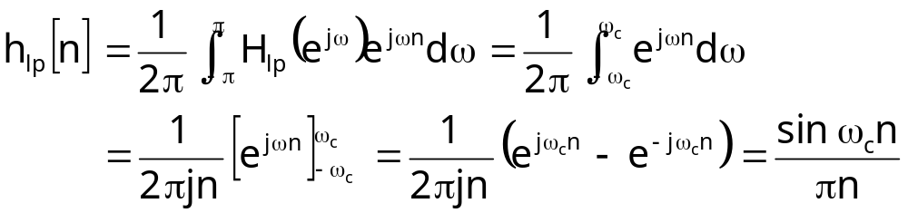
Example: Ideal Lowpass Filter
The periodic DTFT of the ideal lowpass filter is
The inverse can be written as
Not causal
Not absolute summable but it has a DTFT?
The DTFT converges in the mean-squared sense

Slide 28

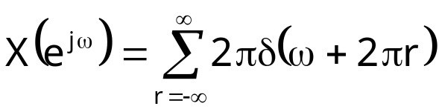
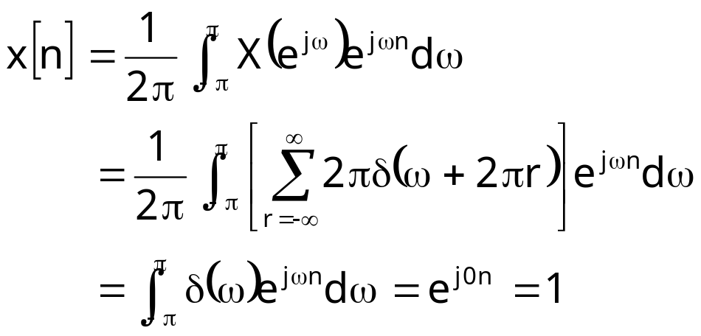
Example: Generalized DTFT
DTFT of
Not absolute summable
Not even square summable
But we define its DTFT as a pulse train
Let’s place into inverse DTFT equation

Slide 29

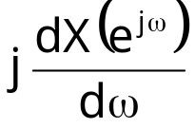
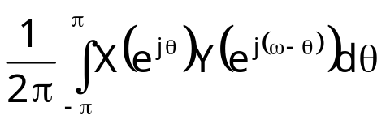
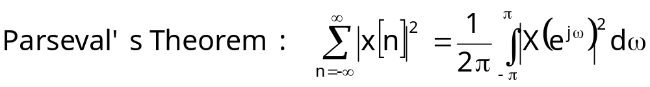

Fourier Transform Theorems
Sequence | DTFT
x[n] y[n] | X(e^{jω}) Y(e^{jω})
ax[n]+by[n] | aX(e^{jω})+bY(e^{jω})
x[n-n_{d}]
x[-n] | X(e^{-jω})
nx[n]
x[n]∗y[n] | X(e^{jω})Y(e^{jω})
x[n]y[n]

Slide 30











Fourier Transform Pairs
Sequence | DTFT
δ[n-n_{o}]
1
a^{n}u[n] |a|<1
u[n]
cos(ω_{o}n+φ)

